Slide 1
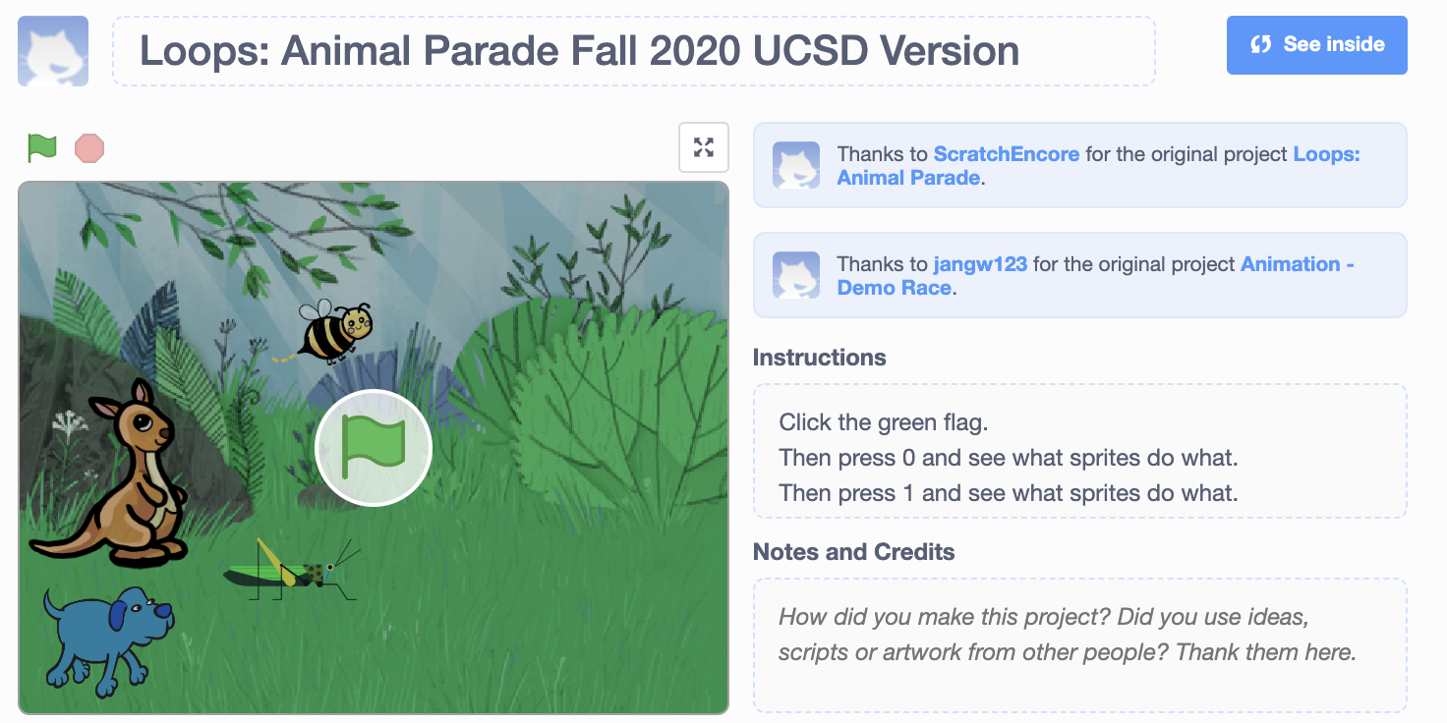
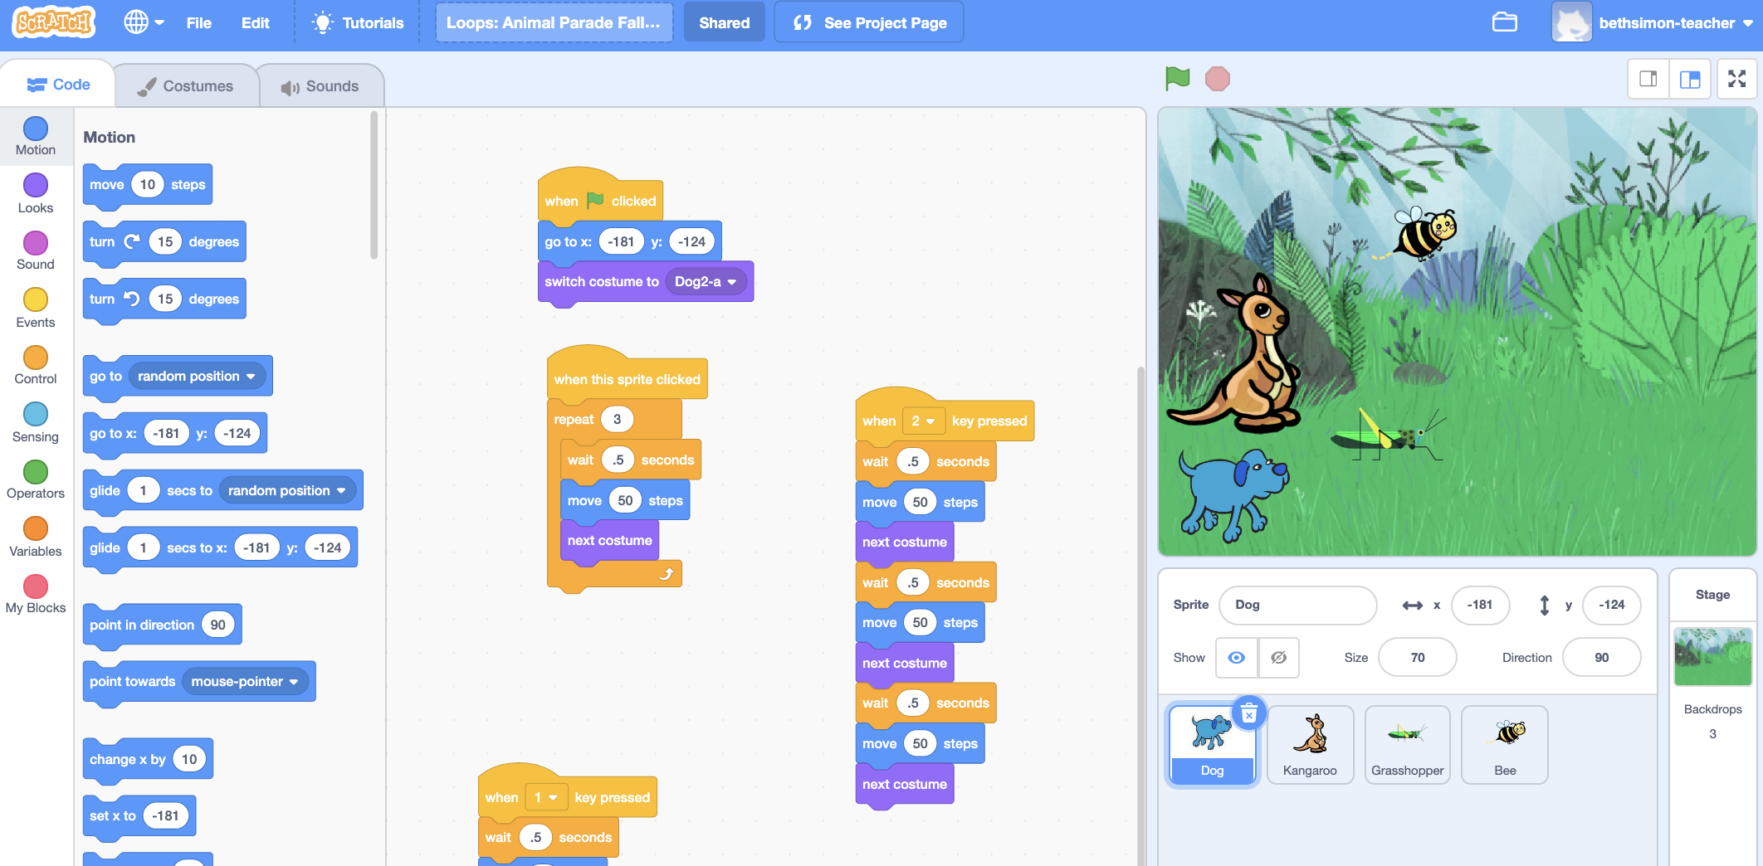
Title
Instructions & Purpose (scroll)
Play
Events
Stage
Script
Sprites

Slide 2
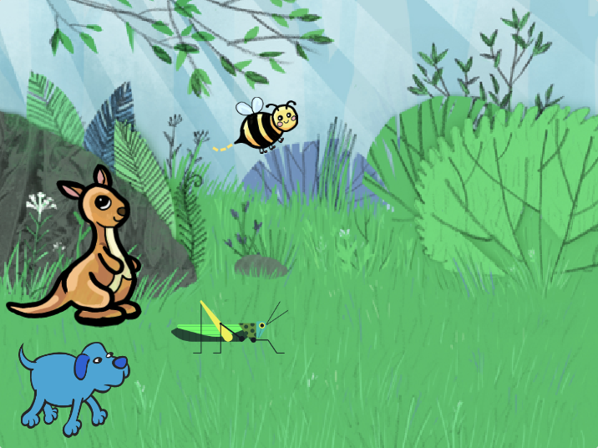
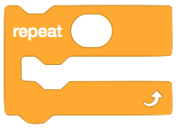


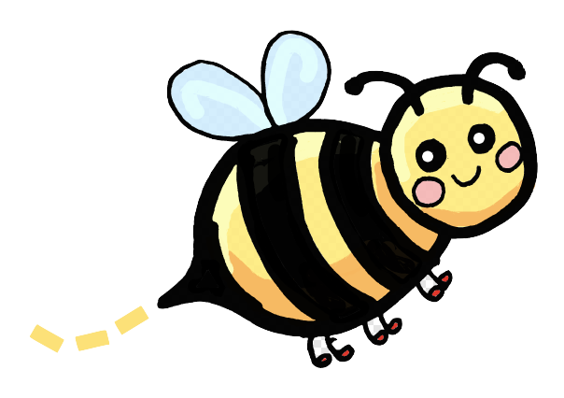

LOOP: ANIMAL PARADE
Go to https://scratch.mit.edu/projects/428258614/
Use a repeat loop to control how many times an action happens
Click for help navigating Scratch!
GET YOUR HEAD IN THE GAME:
Read the title, instructions (how to use it) and purpose (skills you’ll learn)
Press one number at a time and count how many times the Dog walked or the Bee buzzed.
1. Circle the number of times the dog walks.
1
0 1 2 3 4
3
0 1 2 3 4
5
0 1 2 3 4
2
0 1 2 3 4
4
0 1 2 3 4
Play: Click on stuff, circle what you saw
2. Circle the number of times the bee buzzed.
1
0 1 2 3 4
3
0 1 2 3 4
5
0 1 2 3 4
2
0 1 2 3 4
4
0 1 2 3 4
Notes:
https://scratch.mit.edu/projects/428258614/
This lesson has been modified by Beth Simon for use in UCSD classes due to inconsistencies in the Scratch Act 1 curriculum Fall 2020 (Covid pivot). You are encouraged to check out the updated Scratch Act 1 curriculum

Slide 3
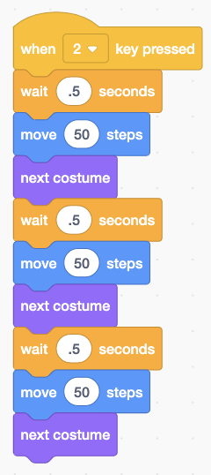

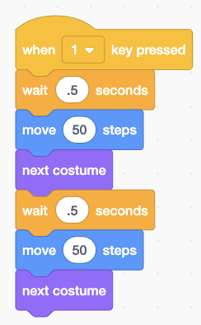
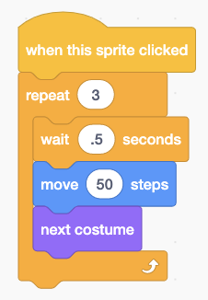
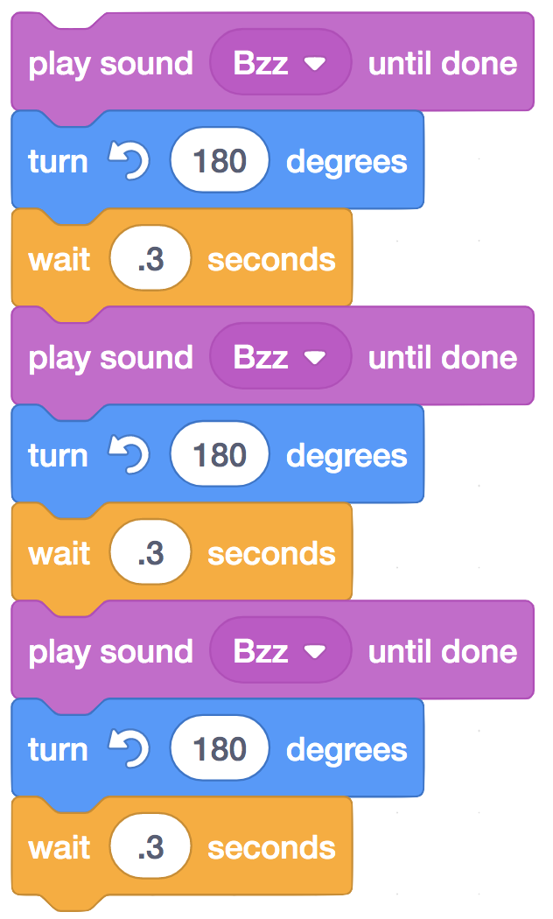
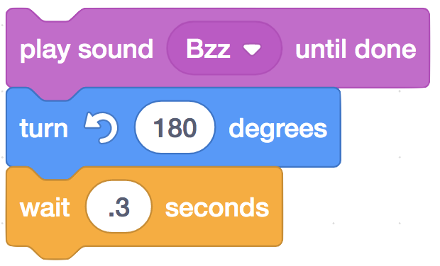
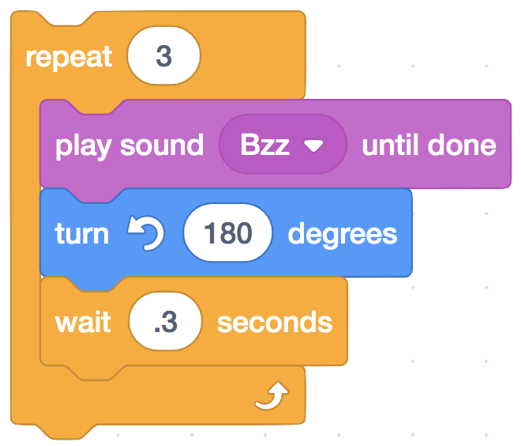

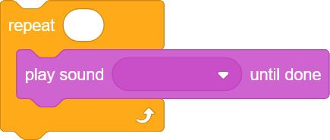
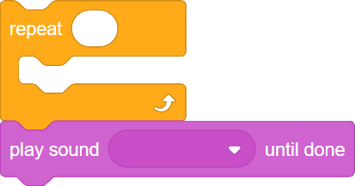

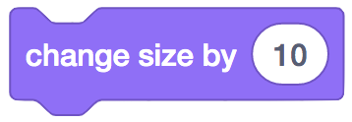


Now let’s Explore the code. Click on to make your own copy.
Click on the sprite tile under the stage to find the sprite's scripts.
3. Circle the two scripts that do the same thing.
4. Circle the two scripts that do the same thing.
Tinker Time! Find Dog’s code. Explore what happens when you:
Add a block into the loop.
Add a block after the loop.
Change the number 3 in the loop to 2. Does the Dog move MORE or LESS?
How many times does the Dog “Sneeze”?
1 2 3 4 5
How many times does the Dog “Sneeze”?
1 2 3 4 5
Your Quest:
Make scripts for the Kangaroo and Grasshopper using a repeat loop.
Make a script that makes the Bee fly around in a circle when it is clicked (use next costume, turn, and move steps blocks).
OTHER BLOCKS TO PLAY WITH

